Slide 1

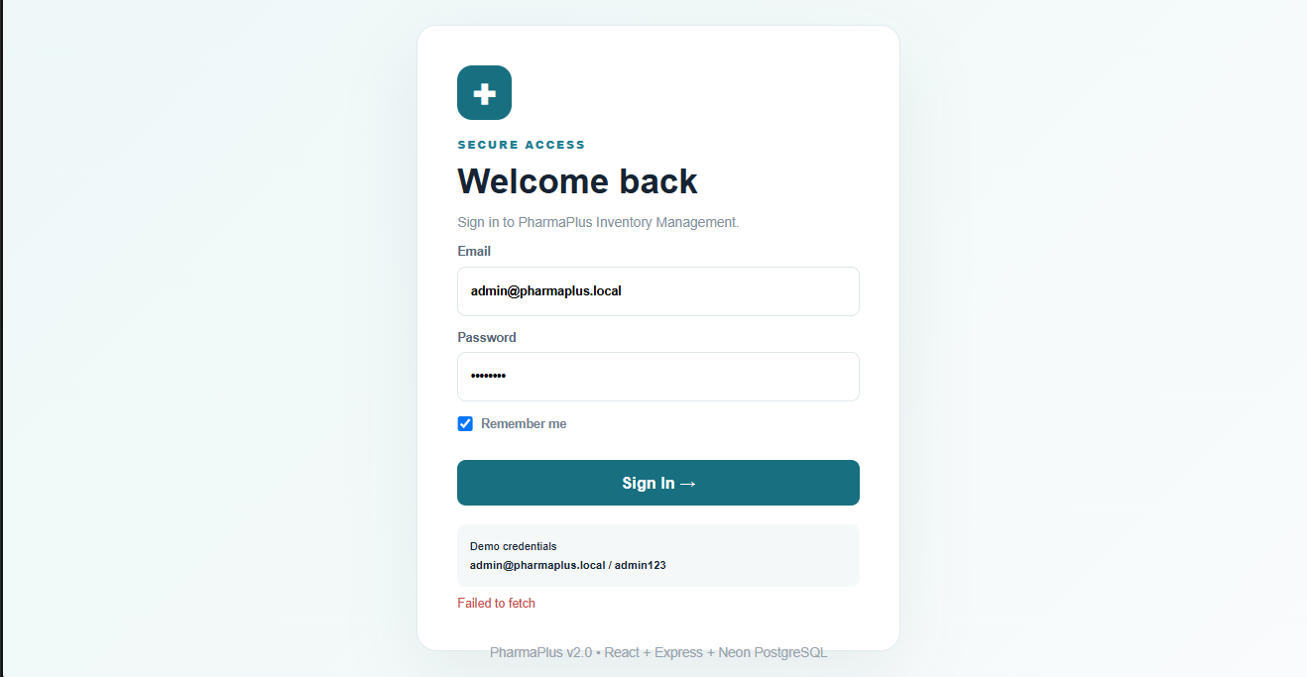
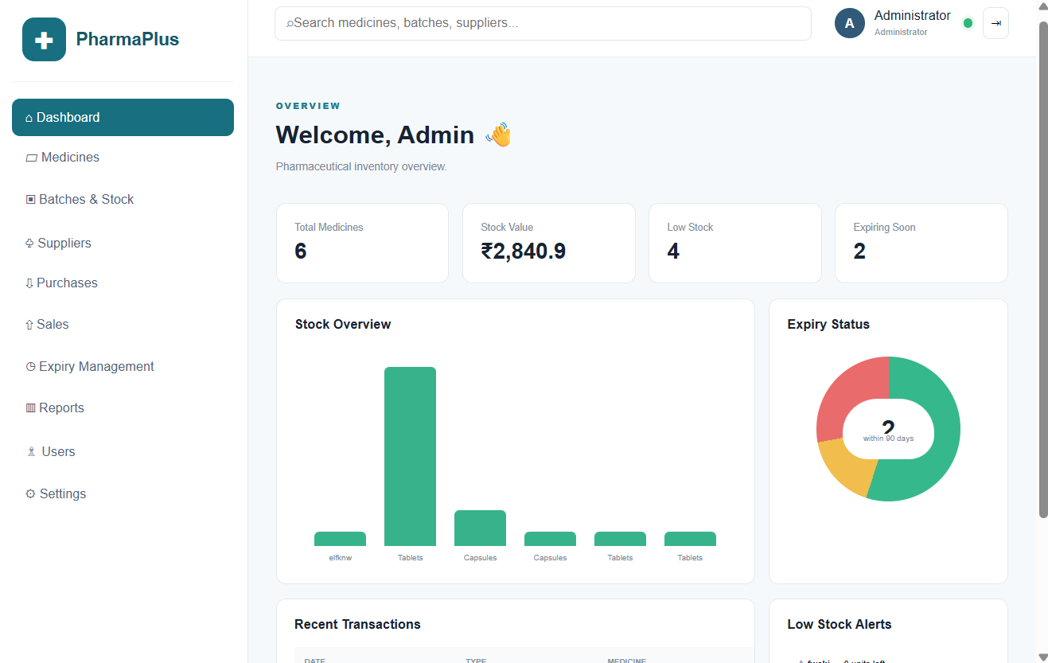
Enterprise Pharmaceutical Stock and Inventory Management System
Team ID: 26 | Section: 8 | Members: K. Girish Chandra – 2520030231, P. Venkat – 2520030450 | Guide: [Dr. ______]
Database Systems Engineering and Distributed Backend Development (25CS1302E) | KLH Bachupally Campus, CSE | PBL 2026-27
Abstract
Tools & Technologies
A Node.js and Express.js REST API backend with MongoDB that centralizes medicines, suppliers, batches, purchases, sales and stock for pharmaceutical businesses.
Automates inventory tracking and flags low-stock and near-expiry medicines, reducing manual effort and errors.
Language & Platform: JavaScript on Node.js
Back-End: Express.js + RESTful APIs
Database: MongoDB (managed with MongoDB Compass)
API Testing: Postman
Tools: Visual Studio Code, npm
Problem Statement & Objectives
Problem: Manual inventory causes duplicate data, human errors, stock shortages, overstocking and missed medicine expiry dates.
Objective 1: Build a centralized RESTful backend for inventory operations.
Objective 2: Track stock, batch and expiry data for traceability.
Objective 3: Flag low-stock and near-expiry medicines for better purchasing.
Scope: Admins and authorized staff; medicine, supplier, batch, sales and stock modules.
System Architecture
Client
Admin / Staff
Postman / UI
JSON
Express.js
REST API
(Node.js)
CRUD
MongoDB
Database
(Compass)
Existing vs Proposed System
API Modules
Medicine • Supplier • Batch • Purchase • Sale • Stock
Feature | Existing System | Proposed System
Data storage | Paper registers / sheets | Central MongoDB database
Stock tracking | Manual counts, errors | Real-time via REST APIs
Expiry tracking | Manual; expiry risk | Batch & expiry dates stored
Purchases & sales | Separate records | Auto-updates stock
Limitation / Gap | Shortages and overstocking | Low-stock & expiry flags
ER Diagram & Database Design
Supplier
Medicine
Available stock = total Batch quantity
supplier_id (PK)
name
contact
address
medicine_id (PK)
name
category
reorder_level
1:N
1:N
Purchase
Batch
Sale
purchase_id (PK)
supplier_id (FK)
batch_no (FK)
quantity
date
N:1
batch_no (PK)
medicine_id (FK)
mfg_date
expiry_date
quantity
1:N
sale_id (PK)
batch_no (FK)
quantity
date
amount
Feasibility Study
Technical: Widely used JavaScript stack (Node.js, Express.js, MongoDB) with plenty of documentation.
Economic: Fully open-source tools (VS Code, Postman, MongoDB Compass); no licensing cost.
Operational: Simple REST APIs are easy for staff to use and easy to maintain.
Schedule: Modular API development fits within the trimester timeline.
Implementation Screenshots
Results & Testing
Conclusion
Future Scope
CRUD APIs for medicines, suppliers and batches tested in Postman.
Stock, low-stock and near-expiry checks validated.
Delivers a reliable, secure and scalable inventory backend.
Cuts manual effort; improves accuracy and stock visibility.
Web / mobile dashboard front-end.
Automated low-stock and expiry alerts (email / SMS).
Role-based login and sales reports.
References: [1] Node.js Documentation – nodejs.org/docs [2] Express.js Guide – expressjs.com [3] MongoDB Manual – mongodb.com/docs [4] Postman Learning Center – learning.postman.com
QR: GitHub

